Slide 1
{"id":"cmpl-7iOWp4uU

Slide 2
{"id":"cmpl-7iOWsifO
South America is home to a diverse range of lizard species, each with unique characteristics and adaptations to various habitats. This comprehensive research explores the fascinating world of South American lizards, highlighting the unique characteristics, habitats, and ecological significance of three remarkable species.

Slide 3
{"id":"cmpl-7iOWvS71
Lizards are an integral part of the South American ecosystem, with a wide variety of species found across the continent. This article provides a brief overview of some of the most notable lizard families and species found in South America, including the Green Iguana.

Slide 4
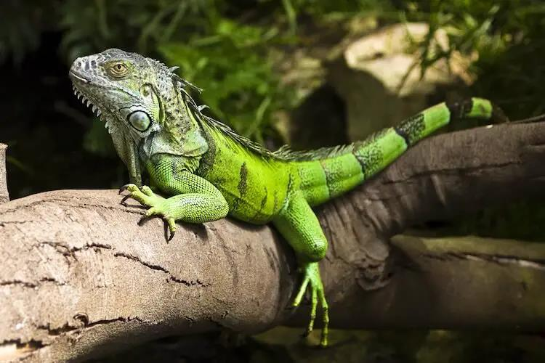

Slide 5
{"id":"cmpl-7iOWyaLk
The Caiman Lizard and the Tepui Lizard are two captivating reptile species found in South America. Both possess unique adaptations that allow them to thrive in their respective environments. However, they face threats, emphasizing the need for conservation efforts to preserve them and their critical roles in the ecosystems they inhabit.

Slide 6
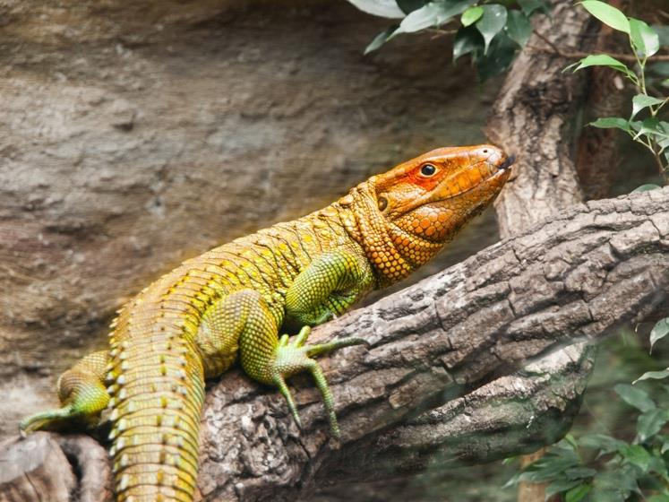

Slide 7
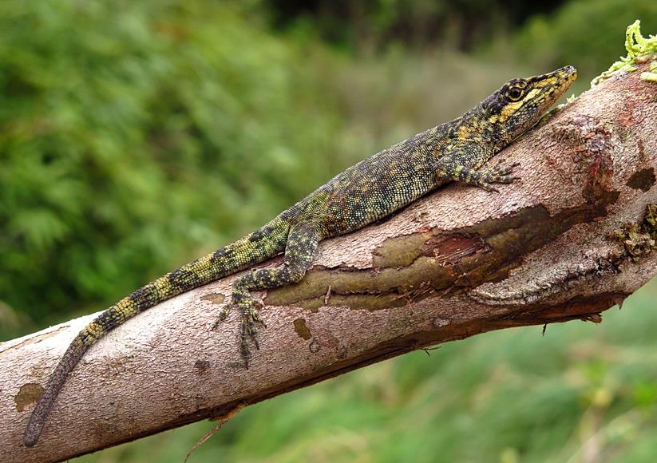

Slide 8
{"id":"cmpl-7iOX2lih
The Green Iguana, Caiman Lizard, and Tepui Lizard are three of the most fascinating and diverse species of lizards found in South America. In this essay, we explore their unique characteristics, ecological roles, and threats they face in their natural habitats.

Slide 9
{"id":"cmpl-7iOX50hC
South America is home to an array of unique lizard species, many of which are threatened by various factors. Responsible research, education, and community involvement are necessary to conserve their habitats and promote their welfare.

